Slide 1

Blockchain
Understanding Blockchain Technology
Samuel Itauma
(Version 1)

Slide 2
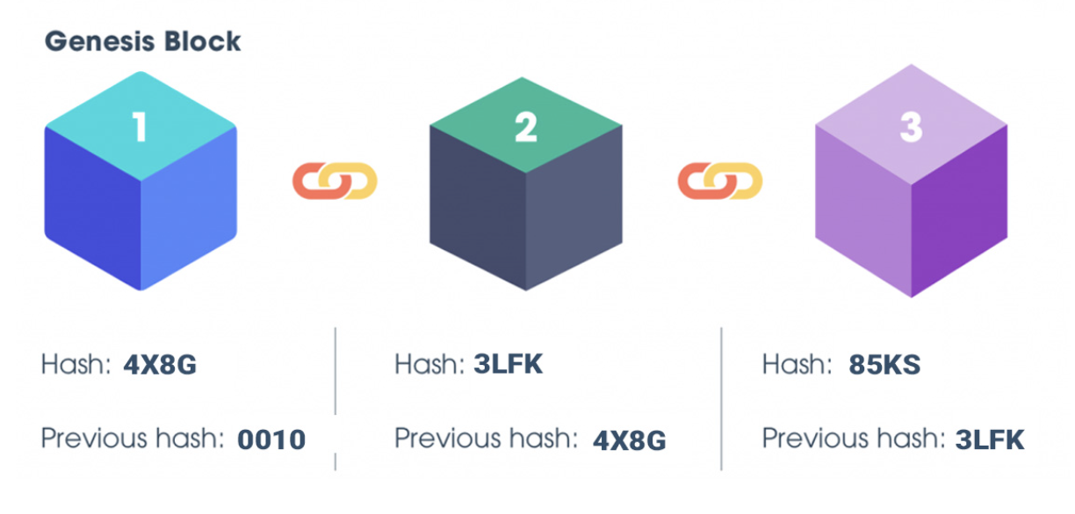
What is Blockchain Technology?
Just like what the name refers to "Block + Chain' - The Blockchain is an immutable chain of blocks containing data. Once a block is added it cannot be changed unless all succeeding blocks are changed as well. This is why it is becoming a popular innovation tactic by business to increase data integrity, security and traceability are all just some of benefits.
To the right is the common structure of a typical blockchain. Each block has the previous blocks hash and its current unique hash.

Slide 3
How does it all work?
We're going to start of by describing the different types of:
Blockchain Networks which are available
Blockchain Data that can be stored
Blockchain Platforms that can be used
Costs which can be expected to occur when using Blockchain Technology

Slide 4
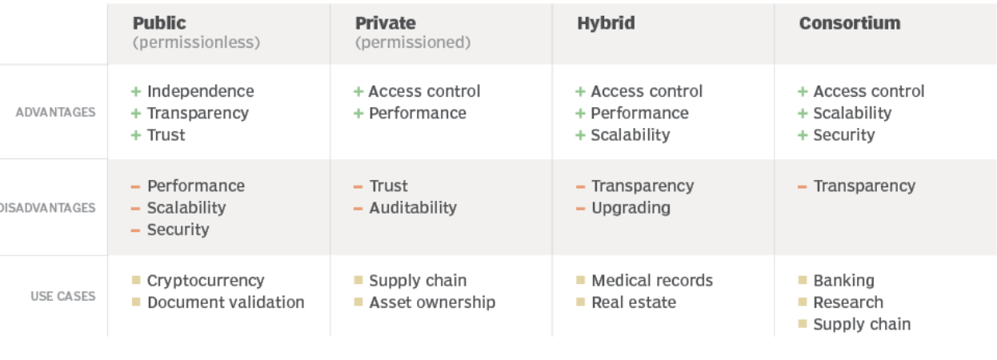
Blockchain Networks
Blockchain networks are broken down into 4 categories: Public, Private, Hybrid and Consortium.
These are vital in your decision making in what type of Blockchain Platform you want to integrate with your business as they all each have their own Advantages +. Disadvantages. More detail on following slides

Slide 5
Blockchain Networks: Public
A Public Network is a de-centralized network which is built on the consensus algorithm which means data to be added to the blockchain must first be verified by mulitple nodes (computers/peers/people) also known as PoW (Proof of Work). In addition there are no restrictions in connecting to this network, and all nodes have the same level of authority resulting in the de-centralized structure not owned by anyone.
Next Page Adv / Dis ->

Slide 6
Blockchain Networks: Public (Adv/Dis)
Advantages | Disadvantages
Decentralization: No central authority controls the network. This makes the network more resilient to attacks and censorship. Hackers would have hack all the nodes Transparency: Anyone can view all the transactions on the network. This makes it easier to verify the authenticity of transactions and reduces the risk of fraud. No permission required: Anyone can join a public blockchain network. This makes it more inclusive and accessible to everyone. Immutability: Once a transaction is recorded it cannot be altered or deleted. This ensures the integrity of the network and reduces the risk of fraud. | Scalability: Public blockchains have limited scalability, which means that they can only handle a limited number of transactions per second. This can lead to slow transaction processing times and high fees during peak usage. Lack of privacy: Public blockchains are transparent, which means that anyone can view all the transactions on the network. This can be a concern for users who want to keep their transactions private. Energy consumption: Public blockchains require a lot of computational power to maintain their security and integrity. This leads to high energy consumption, which can be a concern for environmentalists.

Slide 7
Blockchain Network: Public - 2
WHO WOULD USE A PUBLIC NETWORK?:
A common and most known Public Blockchain example is Cryptocurrencies. This type of blockchain is ideal for organizations that are built on transparency and trust, such as social support groups or non-governmental organizations.

Slide 8
Blockchain Networks: Private
A Private Network is a network that operates in a restricted environment and/or is controlled by a single entity. It essentially works the same as a Public Network in the sense that data to be added needs to be validated by nodes. Since there are restrictions in joining, there are much less nodes correlating to the smaller scale size when compared to Public.
Next Page Adv / Dis ->

Slide 9
Blockchain Networks: Private (Adv/Dis)
Advantages | Disadvantages
Privacy: Private blockchains offer greater privacy compared to public blockchains. Only authorized users can access the network, and transactions can be kept private. Scalability: Private blockchains can be more scalable than public blockchains, as the number of users is limited. This can lead to faster transaction processing times and lower fees. Control: Private blockchains offer greater control over the network, as the network can be customized to suit the needs of the organization. | Centralization: Private blockchains are centralized, as they are controlled by a select group of users. This can lead to concerns about the integrity and security of the network. If there is a attack and multiple nodes are curropted then the Consensus method is compromised Limited inclusivity: Restricted to a select group of users, which can limit their inclusivity and accessibility. Cost: Private blockchains can be more expensive to set up and maintain compared to public blockchains. Forked Chains: Users need to trust each other for smooth functioning, which might not always be possible due to conflicting interests among members of the network. This would disagreements leading to issues like forked chains (two separate cryptocurrencies (old and new)).

Slide 10
Blockchain Network: Private - 2
WHO WOULD USE A PRIVATE NETWORK?:
This network can be used for supply chain management, asset ownership and internal voting. The speed of private blockchains (less nodes) makes them ideal for cases where the blockchain (data) needs to be cryptographically secure (no 3rd parties will see the information) but the controlling entity doesn't want the information to be accessed by the public:
"For example, companies may choose to take advantage of blockchain technology while not giving up their competitive advantage to third parties. They can use private blockchains for trade secret management, for auditing,"

Slide 11
Blockchain Network: Hybrid
A Hybrid Network is when a organisation combines the elements of Public and Private Networks; allowing the organisation to function in a permission based system and a permissionless based system. Therefore this will allow the organisation to control what data can be accessed by certain people and what data can be accessed by the public. Information which is to be kept confidentual can still be verfied by allow access through smart contract (More detail about smart contracts later)
Even though a single entity (organisation ,company) can own the blockchain it still cannot alter transactions.
Next Page Adv/Dis ->

Slide 12
Blockchain Networks: Hybrid (Adv/Dis)
Advantages | Disadvantages
Flexibility: Allows both public and private transactions. It offers the best of both worlds and allows for customisation based on the needs of the application. Security: Public transactions provide immutability and transparency, while private transactions offer privacy and confidentiality. This combination of security features enhances the overall security of hybrid blockchains. Scalability: Public transactions can be used for high-volume, low-security transactions. Meanwhile, private transactions can handle sensitive or high-security transactions. Interoperability: Since Hybrid allows interaction with other blockchains or external networks. This interoperability enables seamless data sharing and collaboration across different blockchain networks or systems. | Complexity: More complex to design, implement, and manage compared to single-type blockchains. The integration of public and private components requires careful planning and coordination. Interoperability Challenges: Interoperability remains a significant challenge for hybrid blockchains. Ensuring seamless data transfer and communication between different blockchains or external networks requires standardized protocols and interfaces. Integration Challenges: Organizations need to ensure compatibility and smooth data flow between different blockchain networks and traditional IT systems. Overcoming integration challenges and establishing robust interfaces are crucial for successful implementation.

Slide 13
Blockchain Networks: Hybrid - 2
WHO WOULD USE A HYBRID NETWORK?:
Hybrid blockchain has several strong use cases, one example is including real estate. Companies can use a hybrid blockchain to run systems privately but show certain information (such as listings- houses) to the public. Medical records can be stored in a hybrid blockchain. The record can't be viewed by random third parties, but users can access their information through a smart contract. Governments could also use it to store citizen data privately but share the information securely between institutions.

Slide 14
Blockchain Networks: Consortium
A Consortium Network is similar to a Hybrid Network in the sense that it uses both Public and Private features. The difference between the two is that Consortium is owned by a collaboration of entities on a de-centralized network. Essentially, a consortium blockchain is a private blockchain with limited access to a particular group, eliminating the risks that come with just one entity controlling the network on a private blockchain.
Next Page Adv/Dis ->

Slide 15
Blockchain Networks: Consortium (Adv/Dis)
Advantages | Disadvantages
Collaboration: Consortium blockchains enable collaboration among a group of organizations. This collaboration can streamline business processes, reduce friction, and enable faster decision-making. Transparency: High level of transparency compared to traditional centralized systems (non-blockchain). Since changes to a consortium blockchain requires all parties agree on the validity of transactions. Security: Consortium blockchains benefit from the security features of public blockchains while maintaining a level of control among the participating organizations- PoW. Governance: Consortium blockchains allow for collective decision-making among the participating organizations. No single organization can exert control on the decision-making process. | Complexity: Consortium blockchains are more complex to set up and manage compared to private blockchains. This is because of the need for collaboration between multiple different entities. Centralisation: Consortium blockchains suffer from a higher degree of centralisation than public blockchains. This may result in operational difficulties if rules and regulations are not clearly defined. Limited Access: Consortium blockchains have restricted access to a specific group of organizations. No one outside these organizations is allowed to operate the blockchain. Trust Issues: Consortium blockchains rely on trust among the participating organizations. This can be problematic in practice, as many competitors may not want to operate transparently.

Slide 16
Blockchain Networks: Consortium -2
WHO WOULD USE A CONSORTIUM NETWORK?:
Consortium can be used in many cases for example Banking and payments are two uses for this type of blockchain. Different banks can band together and form a consortium, deciding which nodes will validate the transactions. Research organizations can create a similar model, as can organizations that want to track food. It's ideal for supply chains, particularly food and medicine applications.

Slide 17

Now lets have a look at the Different types of Data which can be stored on each blockchain Network

Slide 18
Types of Data available: Public
Just to note, data which its stored-on Public can be used in all the other Blockchains. Essentially think of this as the base line. So all the Blockchain Networks have these features (on next page) and I will add the additional features to each blockchain separately in their own category.

Slide 19
Types of Data available: Public
1-Transaction Data – Financial transactions that may include details about a sender, recipient, amount and timestamp.
2-Smart Contract – Contracts that self-execute when the initial terms/agreements are met. These can automate and enforce the execution of predefined rules and actions when certain conditions are met.
3-Cryptocurrencies
4-Tokenized Assets – Assets like real estate, art, or other physical and digital assets can be tokenized and represented on a blockchain. This allows ownership tracking and transparent/trustful transfer.
5-Immutable Records – Once records are added into a public blockchain it cannot be altered or deleted as it would create the whole chain false. Therefore, historical data is preserved all the way.
6-Identity and Authentication Data – identity related information can be stored. Users can prove ownership of their digital identities without relying on a central authority. (This is often done through cryptographic methods). Since added data is Immutable identities cannot be tampered with.
7-Supply Chain Info – This could be tracking the production, shipment, and delivery of products in a supply chain.

Slide 20
Types of Data available: Private
1-Sensitive Business Data – Since this is a private you can store sensitive business data, such as financial records, property records (recording and storing property rights), supply chain information, or proprietary information relevant to the participants in the network.
2-Regulatory Compliance Data – Records may be store here to prove a company is meeting legal requirements or industry standards.
3-Internal Processes and Workflows – Imagine a private blockchain as a special digital communication space for a company. Users can use it to manage projects, share documents, and communicate. It's like having a secure and organized online space for getting work done within the company.
4-Operational Data – Details about how much inventory (products or supplies) is available, how well different parts of the company are performing, or any other data.

Slide 21
Types of Data available: Hybrid + Consortium
Hybrid and Consortium have a combination of all the Data types listed in the previous 2 slides.

Slide 22

Now lets have a look at the Different Blockchain platforms which are available For use

Slide 23
Blockchain Platforms: Bitcoin
In Bitcoin, the blockchain is a public decentralised network and the data within the structure includes the entire history of all the bitcoin transactions. If one node has an error then it uses thousands of other nodes as a reference point to correct itself. Bitcoin uses infrastructure consists of many chained-Blocks: Transactions are grouped into blocks, and each block contains a reference to the previous block, creating a chain of blocks. This structure ensures the chronological order and immutability of transactions.
To add new blocks to the blockchain is called mining. This is done through the Consensus Mechanism where miners solve complex mathematical problems to validate and add transactions to the blockchain. This process secures the network and incentivizes participants. However, this process uses a substantial amount of energy (not eco friendly) and very time consuming as it takes on average 10min for a transaction to be validated.

Slide 24
Blockchain Platforms: Ethereum
Ethereum is a completely decentralized platform and boasts complete support for smart contracts; Ethereum uses a 'Merkle Patricia Trie' data structure to store data. This structure efficiently organizes and retrieves data by using a tree-like structure of nodes it does this by separating the temporary data from the mined transaction data. The data is added to the transaction 'trie' only when the transaction is confirmed. There are three types of 'trie' in Ethereum for data storage:
State Trie: This global state 'trie' is constantly updated and it contains the key-value pair for every account which exists on the Ethereum Network. "Imagine it like a Bank account with Ethereum"
Storage Trie: This stores the contract data. Each Ethereum account has a storage 'trie' and the 256-bit hash value of the storage 'trie’s' root node is stored in the global state 'trie'. Simple words Storage 'trie' is a data structure within Ethereum that organizes and stores contract-specific data for each Ethereum account.
Transaction Trie: Each Ethereum block has its own separate transaction tire. A block would contain many transactions
Next Page for Diagram explaination - >

Slide 25
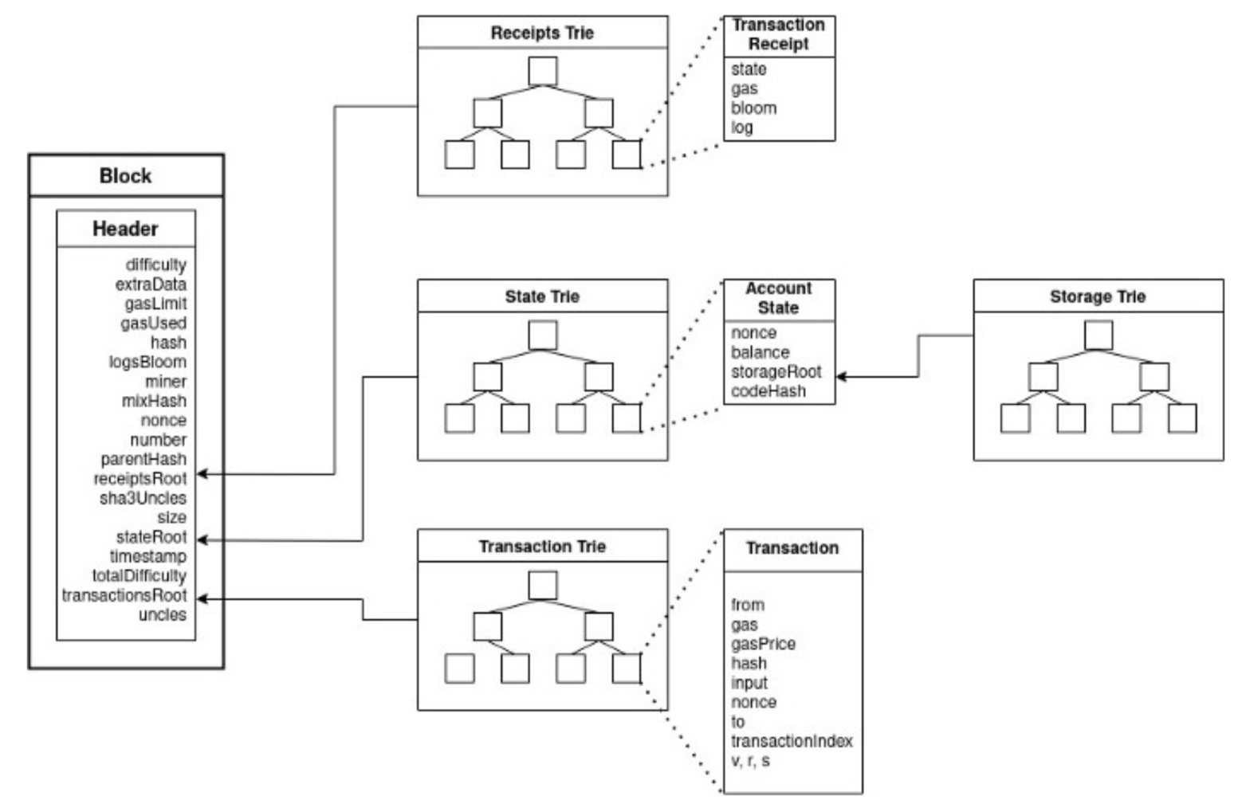
Blockchain Platforms: Ethereum
This is the data block. Data which is being sent
This is the Blockchain 'Block'. This contains the hash result of all the elements.
These are the transaction details, bills...

Slide 26
Blockchain Platforms: Corda
Corda: This is the open-source blockchain platform that doesn’t use the global broadcast. Corda is built to enable direct transactions between parties involved in a specific business agreement or transaction (smart contracts). It can cut the record-keeping cost while at the same time streamlining the business operations. Here, the communication between the peers can be verified without the need to download the whole data due to the use of graphs and persistent queues.
‘Global Broadcast’ = Is used for consensus. This means that every participant in the network receives and validates every transaction. The entire network maintains a copy of the same ledger, providing transparency and ensuring that all participants have a synchronized view of the blockchain's state.

Slide 27
Blockchain Platforms: XRPL
XRPL (XRP Ledger): This is a decentralised public blockchain and uses Global broadcast within their operations. Unlike most other blockchains, the XRPL requires no mining and uses negligible energy, key to long-term growth and stability. Furthermore, XRPL is among the fastest transaction speeds as XRP transactions are validated every three to five seconds.

Slide 28
Blockchain Platforms: IBM
IBM Blockchain: Commercial clients who are less risk-averse have found the fastest blockchain platform with IBM's Blockchain private, decentralized blockchain network. The developer believes that its ability to connect to the business cloud and legacy systems (old systems) more easily than other decentralized networks presents the greatest prospects. This is crucial for businesses that have invested heavily in older technologies and need to modernize without disrupting their current operations. Also, this can be particularly appealing to enterprises that are less willing to take risks associated with a complete overhaul of their existing technology infrastructure.

Slide 29
Blockchain Platforms: EOSIO
EOSIO: Regarded as the "top open-source platform" for companies and programmers using blockchain, according to Eosio. It is quick and adaptable, supports scaling, is highly configurable, and gives developers various tools and resources. In addition to this is provides users with dApps' hosting and smart contract capabilities.
Due to Eosio's foundation in C++ (general-purpose programming and coding language), both private and public networks can benefit from its "very flexible" environment.

Slide 30
Blockchain Platforms: Hyperledger

Slide 31
What technical requirements would we need if we want to connect to these?
Technical Requirements Blockchain Network:
Node Setup: Node Setup will be needed to be able to connect to a blockchain network as this computer contains a copy of the blockchain ledger.
Software Instillation: Instillation of the necessary software will be needed to access/use the blockchain, and this should be outlined by the blockchain provider.
Synchronisation: Synchronize your node (computer) with the blockchain network. (This involves installing the entire blockchain to your node, time required will depend on the size of the blockchain and internet connection strength)
API Keys: Collect an API key if the blockchain requires it.
Programming Packages/Strong Understanding in a language: Choose the correct programming languages/ SDKs (software development kits, all the tools you’d need in one place) to help you interact or develop in the blockchain network.
Security Evaluations: Check the security structure of the network (Public or Private) then implement security practises to protect your sensitive data or private keys.

Slide 32

Costs which can be expected to occur when using Blockchain Technology?

Slide 33
Potential Costs
Factors to consider:
Development and Implementation Costs: Developing and implementing blockchain solutions often require special knowledge/expertise. Therefore it would be recommended to hire a blockchain developer/consultant to handle this process.
Infrastructure Costs: Since Blockchains system typically require a decentralised network of nodes to maintain the distributed ledger. Depending on the blockchain platform setting up and maintaining this infrastructure can involve in hardware costs. E.g Servers, Storage, Cooling systems.
Training and Education: Integrating blockchain technology may require training existing staff or hiring new personnel with blockchain expertise. Providing training programs or enlisting external training services can incur additional costs to ensure the team has the necessary knowledge to manage and utilize the technology effectively.
Next Page for more

Slide 34
Potential Costs
Security and Auditing: Blockchain technology can enhance security through its decentralized and immutable nature. However, ensuring the security of the overall system, including data encryption, smart contract audits, and protection against hacking attempts, is crucial. Implementing robust security measures and conducting regular audits can lead to additional costs.
Scalability Considerations: Scaling blockchain networks can be challenging and may involve additional costs. As the number of transactions increases, the network's capacity and performance need to be maintained. Depending on the chosen blockchain platform, scaling solutions such as sharding or layer-two protocols may require additional investments.
Regulatory and Compliance Costs: Depending on the industry and jurisdiction, integrating blockchain may introduce additional compliance requirements and regulatory obligations. Ensuring adherence to relevant regulations, such as data privacy laws or anti-money laundering regulations, may involve additional costs for legal consultations, compliance audits, and implementing necessary measures.

Slide 35
My Thoughts
The blockchain is a revolutionary system for securely recording transactions, but it still suffers from one major flaw secrecy. The entire point of using a blockchain is distributed trust and the ability to verify transactions in a trustless environment. While this sounds intreaging, the reality is that it can only be used to encrypt data with public access (so any data you want to verifiy you must be comfortable sharing with the public). If a user wishes to have complete control over his/her data, he/she will need to keep it local or use an external device.

Slide 36
My Thoughts: What is can be used for
1- Automation
2- Data intergrity: Iot devices (Where did the data come from?, is the data good?)
3-Supply chain: Retail Business (Checking and securing the product transfer process)

